Slide 1
DeepPurple
PI: Vahid Tarokh
Yu Xiang, Yuting Sun, Enmao Diao, Jie Ding, Jiawen Zhou
School of Eng. & Applied Sciences (SEAS)
Harvard University

Slide 2
Duke Data: Overview

Slide 3
Duke Data
Goal: Predict infection after the inoculation within shortest time range
Focus on: Physiological sensor data + RNA-seq
Physiological sensor data (wearable device):
Electro-dermal activity (EDA),
Heart rate (HR)
Skin temperature (Temp)
Features of physiological sensor data
Easy to collect and low expense
Less informative

Slide 4
Duke Data: Our Approach
Our approach:
Classification based on two main features:
spectral distances of Physiological sensor data;
RNA-seq

Slide 5
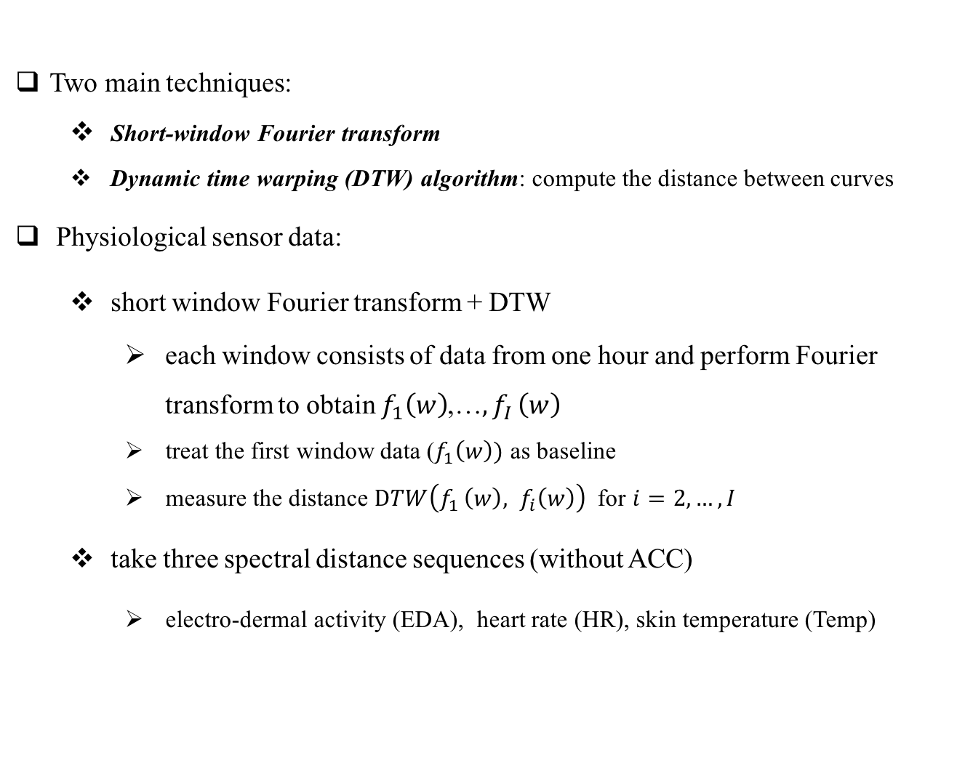
Duke Data: Physiological Sensor Data
Two main techniques:
Short-window Fourier transform
Dynamic time warping (DTW) algorithm: compute the distance between curves
Physiological sensor data:
short window Fourier transform + DTW
each window consists of data from one hour and perform Fourier transform to obtain $f_{1}\left(w\right)$,…${,f}_{I}\left(w\right)$
treat the first window data ($f_{1}\left(w\right))$ as baseline
measure the distance $DTW\left(f_{1 }\left(w\right), f_{i}\left(w\right)\right)$ for $i=2,…, I$
take three spectral distance sequences (without ACC)
electro-dermal activity (EDA), heart rate (HR), skin temperature (Temp)

Slide 6
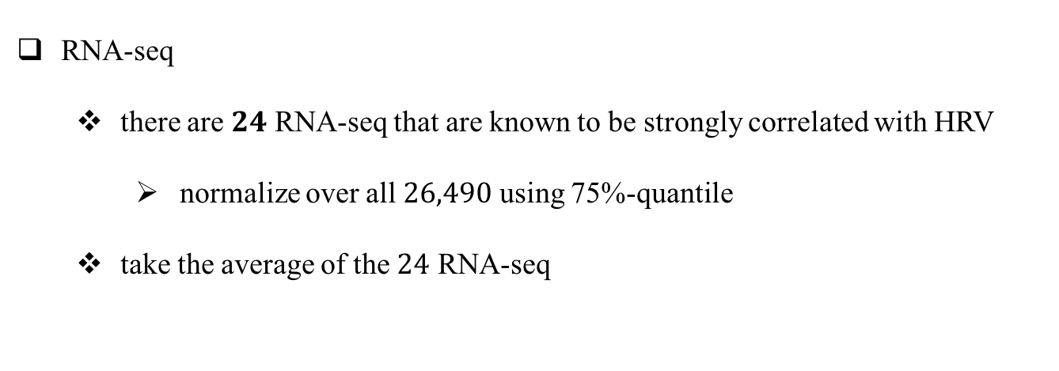
Duke Data: RNA-seq
RNA-seq
there are $24$ RNA-seq that are known to be strongly correlated with HRV
normalize over all $26,490$ using 75%-quantile
take the average of the $24$ RNA-seq

Slide 7
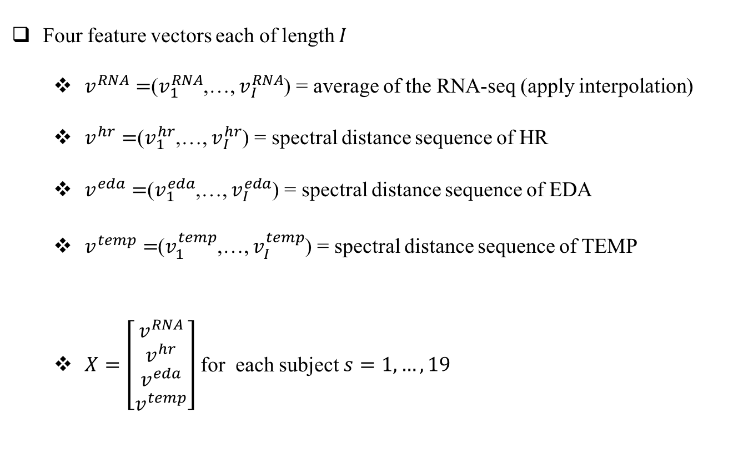
Summary Results
Four feature vectors each of length $I$
$v^{RNA}=$($v_{1}^{RNA}$,…, $v_{I}^{RNA}$) = average of the RNA-seq (apply interpolation)
$v^{hr}=$($v_{1}^{hr}$,…, $v_{I}^{hr}$) = spectral distance sequence of HR
$v^{eda}=$($v_{1}^{eda}$,…, $v_{I}^{eda}$) = spectral distance sequence of EDA
$v^{temp}=$($v_{1}^{temp}$,…, $v_{I}^{temp}$) = spectral distance sequence of TEMP
$X=\left[\begin{matrix}\begin{matrix}v^{RNA} \\ v^{hr}\end{matrix} \\ v^{eda} \\ v^{temp}\end{matrix}\right]$ for each subject $s=1,…,19$

Slide 8
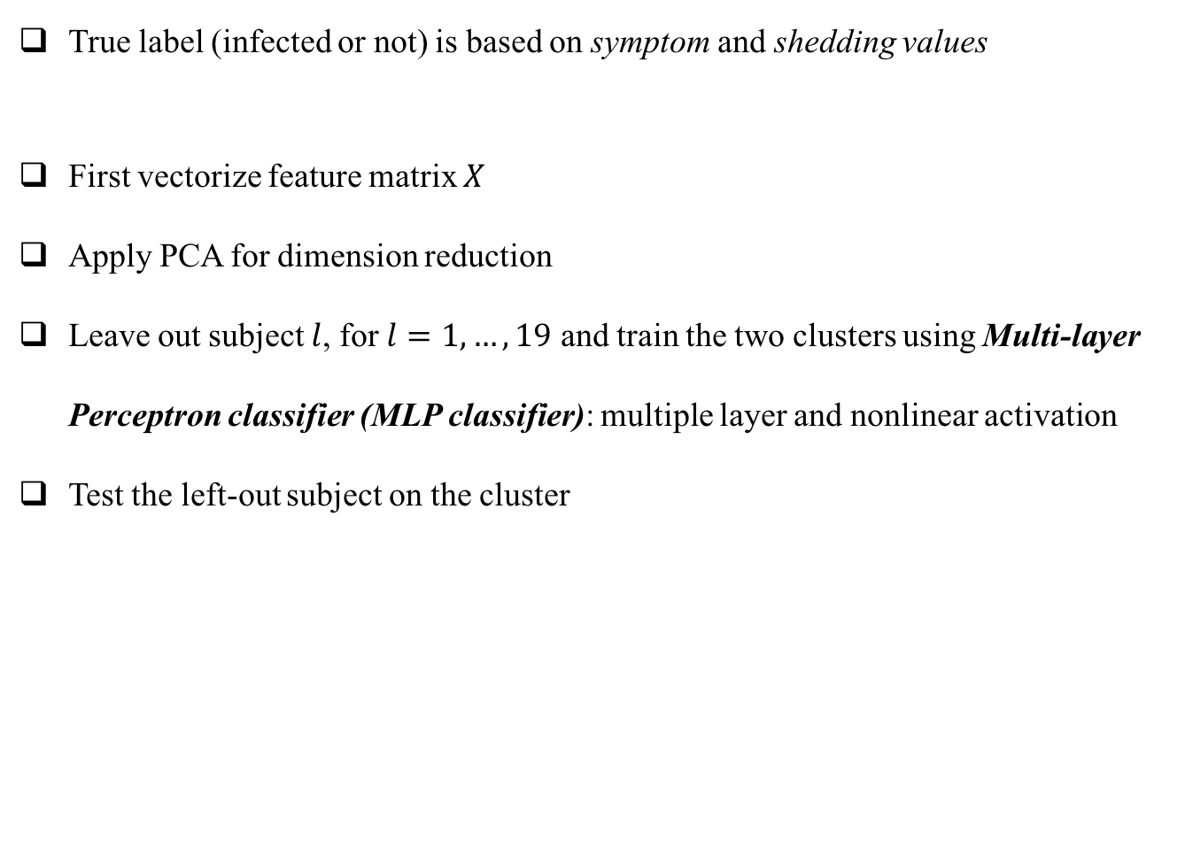
Summary Results: Classification
True label (infected or not) is based on symptom and shedding values
First vectorize feature matrix $X$
Apply PCA for dimension reduction
Leave out subject $l$, for $l=1,…,19$ and train the two clusters using Multi-layer Perceptron classifier (MLP classifier): multiple layer and nonlinear activation
Test the left-out subject on the cluster

Slide 9
Summary Results
Because of the missing data of subject 020 within the first 27 hours after inoculation, we look at a 24-hour window starting from 27 hours after inoculation
The size of the feature matrix is 4 by 24 for each of the 19 subjects
First, treat the feature matrix as a 96-dimensional vector
Second, apply PCA on 19 by 96 to reduce to 10 principle components
Fig: Magnitudes of the
principle components

Slide 10
Summary Results
Compare the results between with and without physiological sensor data
We use default value for MLP classifier
Without physiological sensor data,
i.e., only using RNA-seq
Accuracy rate is 73.7%

Slide 11
Summary Results
With physiological sensor data
Accuracy rate is 78.9%

